Slide 1
AI-Powered Travel Recommendation System
CAPSTONE PROJECT
Presented By:
Student Name- PRAVALLIKA VETAPALEM
College Name- KITS AKSHAR INSTITUTE OF TECHNOLOGY
Department- AI & DS

Slide 2
OUTLINE
Problem Statement (Should not include solution)
Proposed System/Solution
System Development Approach (Technology Used)
Algorithm & Deployment
Result
Conclusion
Future Scope
References

Slide 3

Problem Statement
.
Planning travel across India is challenging due to the vast
number of tourist destinations available. Travelers often struggle
to identify similar places based on their interests such as historical
sites, religious landmarks, natural attractions, or cultural destinations.
Most travel platforms provide basic filtering (city, rating, budget),
but they do not intelligently recommend destinations similar to a
selected place. This makes discovering related tourist spots
time-consuming and inefficient.
There is a need for an intelligent system that helps users
discover relevant and similar tourist destinations efficiently

Slide 4
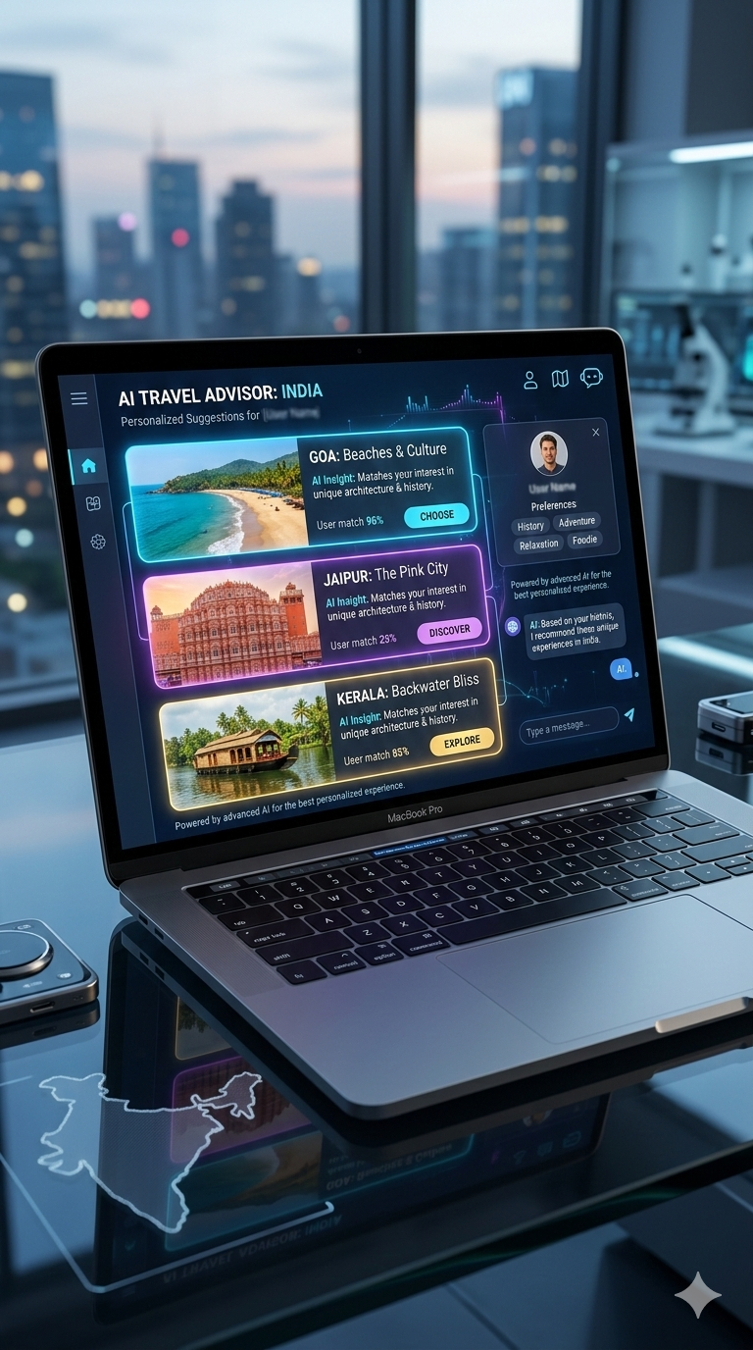
Proposed Solution
The proposed system is an AI-Powered Travel Recommendation System that suggests tourist destinations similar to a user-selected location.
The system:
Accepts a selected tourist place from the user
Analyzes its features (type, significance, zone, best time, etc.)
Computes similarity with other destinations
Recommends top N similar places
The application provides an interactive web interface built using Streamlit for user-friendly interaction.

Slide 5
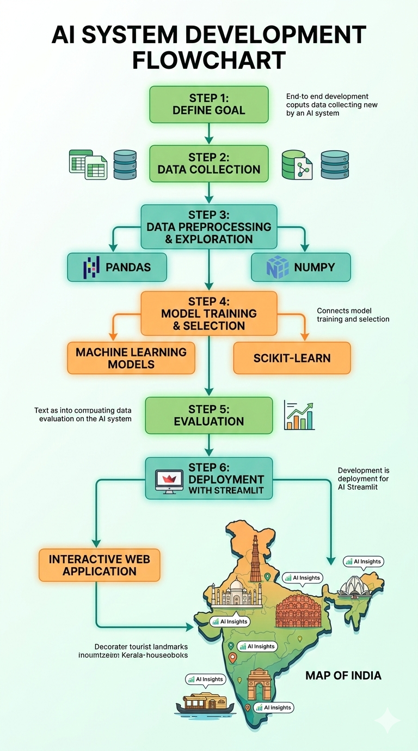
System Approach
Hardware Requirements:
Processor: Intel i3 or higher
RAM: Minimum 4 GB
Storage: Minimum 10 GB free space
Software Requirements:
Operating System: Windows
Programming Language: Python 3.x
Development Environment: Google Colab, Notepad
Web Framework: Streamlit
Libraries Used:
NumPy – Numerical computations
Pandas – Data handling
Scikit-learn – TF-IDF & Cosine Similarity
Matplotlib – Visualization

Slide 6
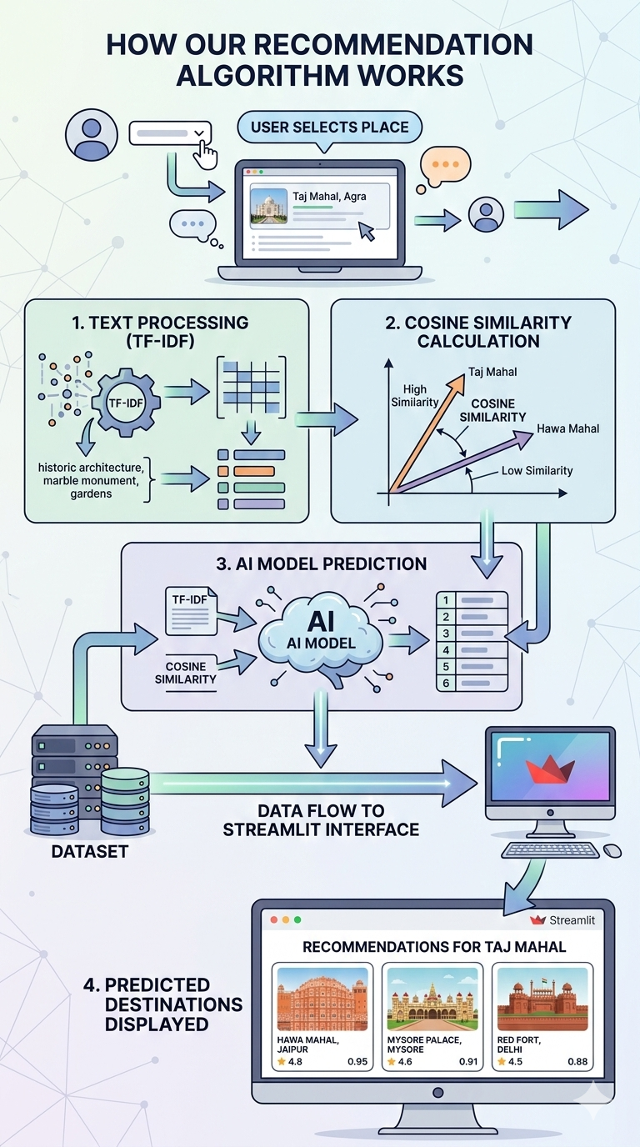
Algorithm & Deployment
Algorithm: Content-Based Filtering
Algorithm Selection: Content-Based Filtering is used for tourist place recommendation. Chosen because it suggests places based on user interests and preferences.
Data Input: Location Budget Travel Duration Travel Type (Adventure, Nature, Historical, Spiritual) Ratings
Training Process: Tourist places dataset collected Data cleaned and categorized Features encoded and similarity calculated
Recommendation Process: User inputs travel preferences System compares preferences with dataset Top matching places recommended

Slide 7
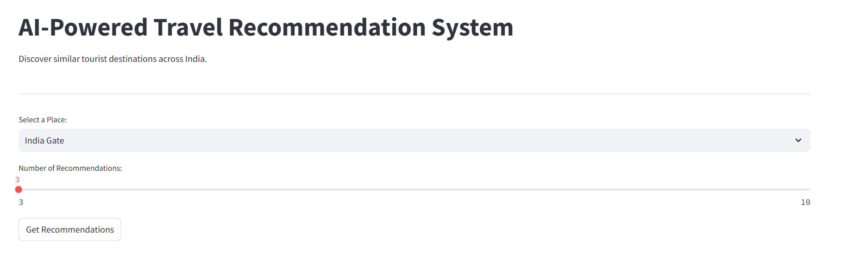
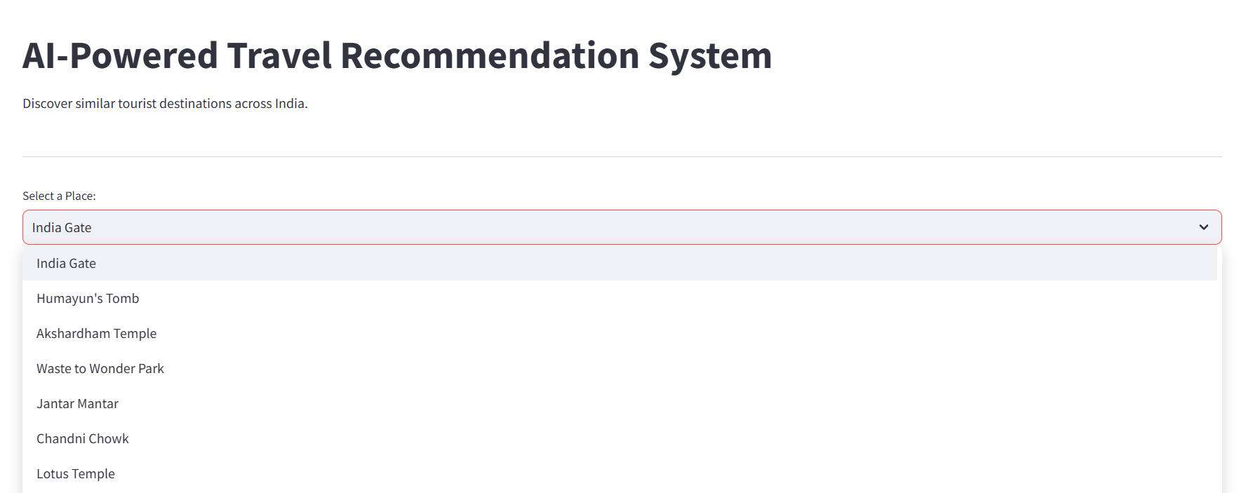
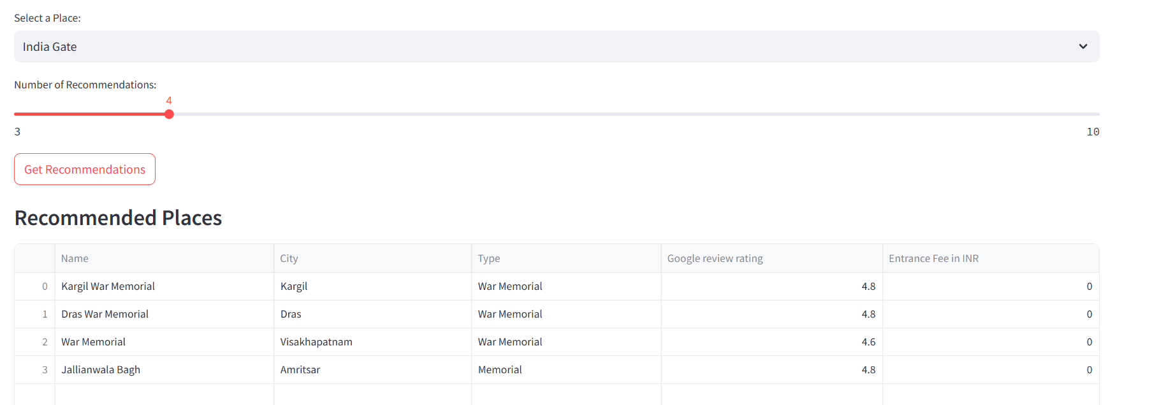
Result
The system successfully recommends tourist destinations based on similarity of features.
Selecting a war memorial recommends other historical memorials.
Selecting a temple recommends religious destinations.
Recommendations are adjustable based on user-selected number of places.
Results are displayed in a clean and scrollable interface, making it easy to explore multiple destinations.
Observation: The system improves travel planning by suggesting relevant tourist spots efficiently, saving time and effort for users.

Slide 8
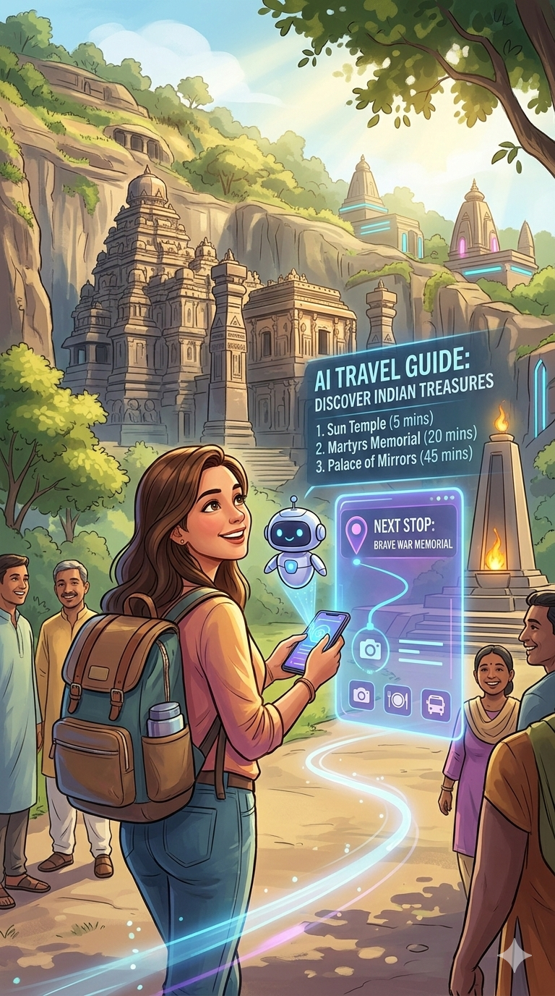
Conclusion
The AI-Powered Travel Recommendation System effectively
suggests relevant tourist destinations across India.
By analyzing features like type, significance, and
location, the system provides accurate, personalized recommendations.
It simplifies travel planning, helps users discover new
places, and offers a clean, interactive interface for easy exploration.

Slide 9
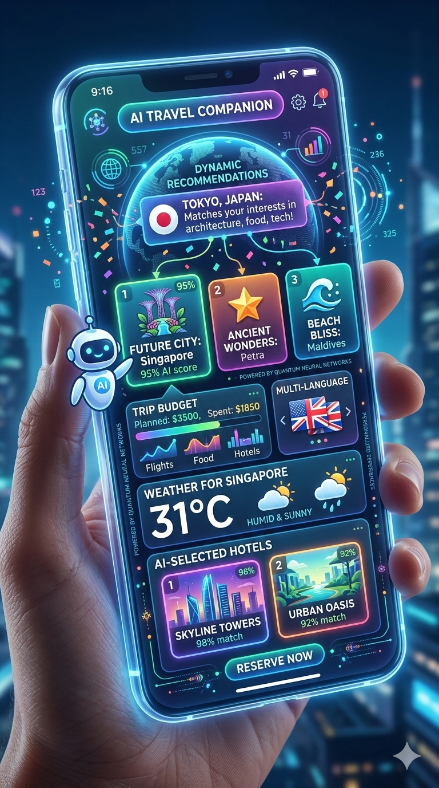
Future scope
Add hybrid recommendations
combining user preferences, ratings, and budget
Integrate images and maps
for better user experience
Include real-time user reviews and feedback
Deploy as a mobile app
on-the-go travel planning
Use deep learning embeddings
for more accurate similarity-based suggestions
Extend to international tourist destinations

Slide 10
References
Kaggle – Travel Dataset: Guide to India’s Must See Places https://www.kaggle.com/datasets/saketkumar/travel-dataset
Scikit-learn – TF-IDF & Cosine Similarity https://scikit-learn.org/stable/modules/feature_extraction.html#text-feature-extraction
Streamlit Documentation – Web Application Development https://docs.streamlit.io
Python Official Documentation – Pandas, NumPy, Pickle https://docs.python.org/3/
Research on Content-Based Recommendation Systems https://www.sciencedirect.com/science/article/pii/S0957417417305577

Slide 11
Github link
Github Link :https://github.com/vetapalem-pravallika/AI-Powered-Travel-Recommendation-System
Deployment Link: https://ai-powered-travel-recommendation-system-ibqx2aqgzadgacqyk3wxwz.streamlit.app/

Slide 12
THANK YOU

